Slide 1
Voltage Regulators
Definition:
Voltage regulators are integrated circuits designed to regulate the voltage at their input to a constant, fixed voltage at their output, irrespective of changes in load current or input voltage.
Types of voltage regulators
The two categories include:
1. Series/Linear voltage regulators (Fixed or Variable)
2. Switching voltage regulators

Slide 2
Voltage Regulators
1. Series/Linear voltage regulators (Fixed or Variable)
Use the principles of voltage dividers to transform the voltage at their input to the desired voltage at their output.
They employ a feedback loop that automatically varies the resistance in the system to counter the effect of variations in the load impedance and input voltage, all to ensure the output voltage is kept constant.
Typical implementations of linear voltage regulators involve the use of FETs as one side of a voltage divider with a feedback loop connected to the gate of the transistor, driving it as required to ensure consistency in the output voltage.
Some popular examples of linear voltage regulators include the 78xx (e.g L7805(5v), L7809(9V)) series of voltage regulators.

Slide 3
Voltage Regulators
1. Series/Linear voltage regulators (Fixed or Variable)
Pros
1. Simple and easy to design and implement
2. Generates a lower amount of EMI and noise
3. Fast response time to changes in load current or input voltage conditions
4. Low ripple voltage at the output
Cons
1. Low efficiency as a large amount of electrical energy is wasted as heat
2. Drop-out voltage makes them a bad choice for low power applications
3. Occupy more space on PCB due to their need for heat sinks
4. Low efficiency as a large amount of electrical energy is wasted as heat
5. Drop-out voltage makes them a bad choice for low power applications
6. Occupy more space on PCB due to their need for heat sinks

Slide 4
Voltage Regulators
2. Switching voltage regulators
Switching voltage regulators are super-efficient regulators used in scenarios where power loss, as in linear regulators, cannot be condoned.
The voltage regulation mechanism in switching voltage regulators involves rapidly switching an element connected in series with an energy storage component (capacitor or inductor) to periodically interrupt the flow of current and transform the voltage from one value to the other.
Unlike in linear voltage regulators, the switching element is either in a fully conducting or switched-off state.
It dissipates no power and allows the regulator to attain a high level of efficiency beyond that of the linear regulators.

Slide 5
Voltage Regulators
2. Switching voltage regulators
Pros
Small size
High efficiency
They can provide an output voltage that is greater than or less than the input voltage
Fits low power applications
Cons
Complicated design
Requires more additional components
Expensive
High EMI and noise generation rates that could affect product certification if not properly managed
High output voltage ripple
Slower transient recovery time compared to linear regulators

Slide 6
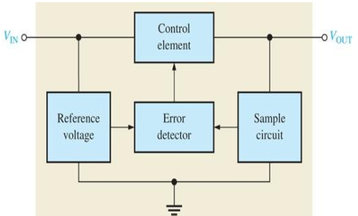
Voltage Regulators
1. Series/Linear voltage regulators (Fixed or Variable)
Control element in series with load between input and output.
Output sample circuit senses a change in output voltage.
Error detector compares sample voltage with reference voltage → causes control element to compensate in order to maintain a constant output voltage .

Slide 7
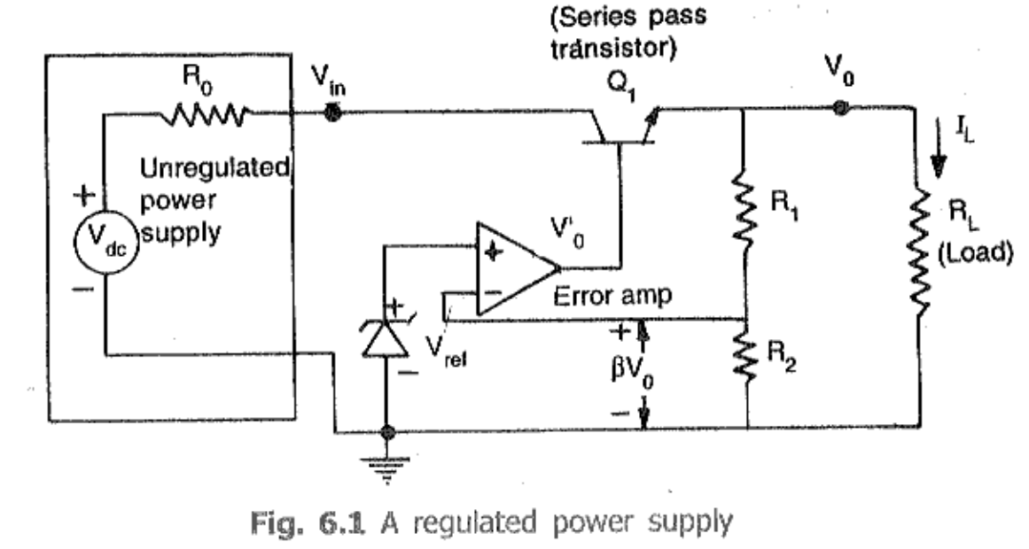
Voltage Regulators
1. Series/Linear voltage regulators (Fixed or Variable)

Slide 8
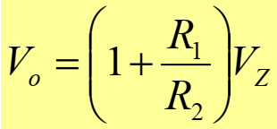

Voltage Regulators
1. Series/Linear voltage regulators (Fixed or Variable)
The resistor R1 and R2 sense a change in the output voltage and provide a feedback voltage. The error detector compares the feedback voltage with a Zener diode reference voltage.
The resulting difference voltage causes the transistor Q₁ controls the conduction to compensate the variation of the output voltage.
The output voltage will be maintained at a constant value of
The transistor Q1 is the series control element. Zener diode provides the reference voltage.
Since Q1 is an npn transistor (Emitter Follower), Vo is found as

Slide 9
Voltage Regulators
1. Series/Linear voltage regulators (Fixed or Variable)
The response of the pass-transistor to a change in load resistance as follows:
If load resistance increases, load voltage also increases.
Since the Zener voltage is constant, the increase in Vo causes VBE to decrease.
The decrease in VBE reduces conduction through the pass- transistor, so load current decreases.
This offsets the increase in load resistance, and a relatively constant load voltage is maintained .

Slide 10
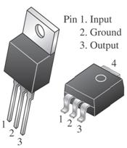
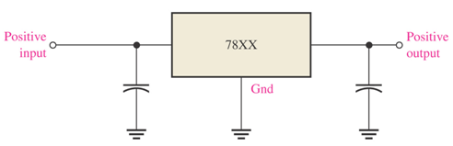
Voltage Regulators
Fixed voltage regulators
The fixed voltage regulator has an unregulated dc input voltage Vi applied to one input terminal, a regulated output dc voltage Vo from a second terminal, and the third terminal connected to ground
The series 78XX regulators are the three-terminal devices that provide a fixed positive output voltage.

Slide 11
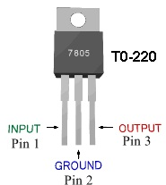
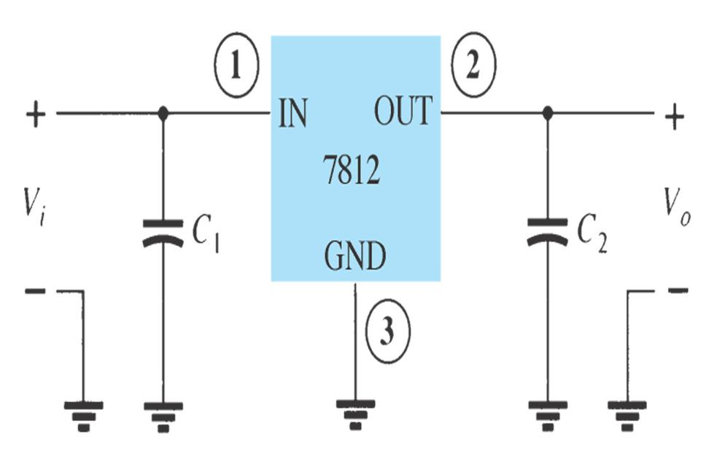
Voltage Regulators
Fixed voltage regulators
C₁ is to reduce Inductive effects
C₂ is to improve Transient effects

Slide 12
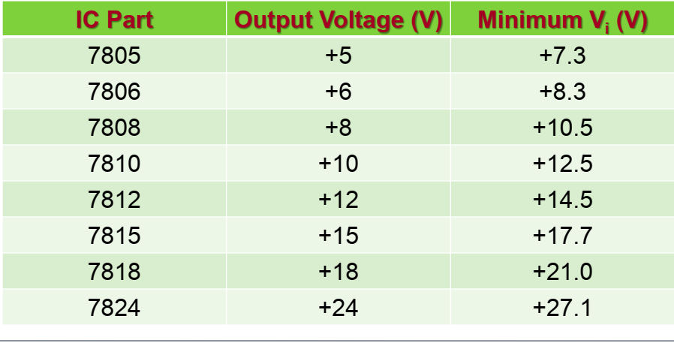
Voltage Regulators
Fixed voltage regulators
An unregulated input voltage Vi is filtered by a capacitor C1 and connected to the IC’s IN terminal.
The IC’s OUT terminal provides a regulated +12 V, which is filtered by capacitor C2.
The third IC terminal is connected to ground (GND) .
Positive-Voltage Regulators in the 78XX Series

Slide 13
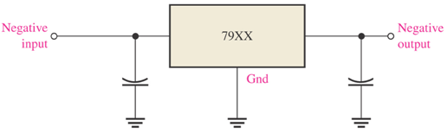
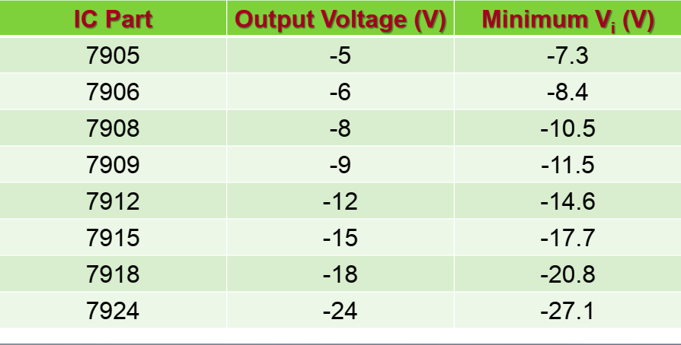
Voltage Regulators
Fixed Negative voltage regulators
The series 79XX regulators are the three-terminal IC regulators that provide a fixed negative output voltage

Slide 14
Voltage Regulators
Characteristics
Output voltage (or voltage range)
Output current
Input voltage range
Operating temperature range
Drop-out voltage
Line regulation
Line regulation is the ability of the power supply to maintain its specified output voltage over changes in the input line voltage. It is expressed as percent of change in the output voltage relative to the change in the input line voltage.
Load Regulation
Load regulation is the ability of the power supply to maintain its specified output voltage given changes in the load. This does not mean the tolerance applies when there are sudden changes in load, it means over the permissible load range the regulation can change by this amount.

Slide 15
Voltage Regulators
Ripple Rejection
The ripple rejection ratio is the ratio of the ripple voltage that appears on the output voltage when the ripple voltage component (noise) is superimposed on the input voltage to the input ripple voltage.
The larger this value, the smaller the ripple component that appears in the output.
The Monolithic regulators has in-built circuits for,
Over-Current Protection
Thermal Overload Protection

Slide 16
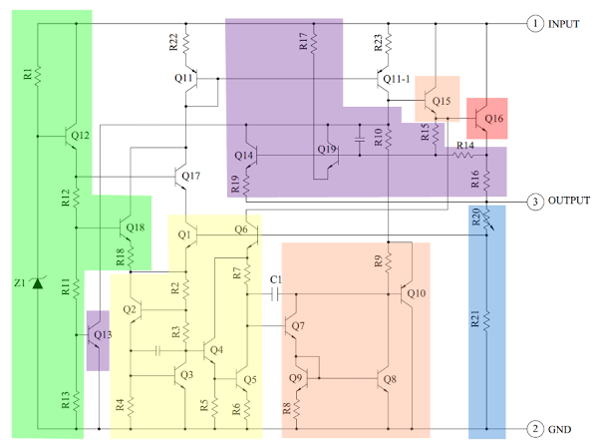
Voltage Regulators
Schematic of 7805 IC

Slide 17
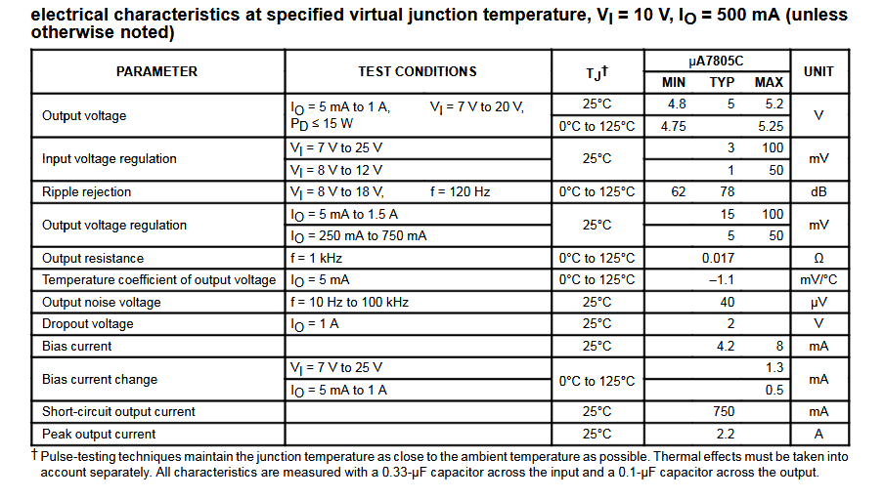
Voltage Regulators
Electrical Characteristics

Slide 18
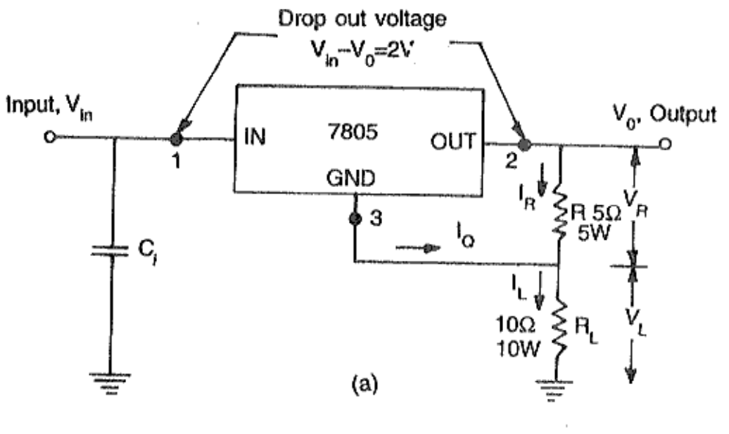
Voltage Regulators
7805 as Current Source

Slide 19
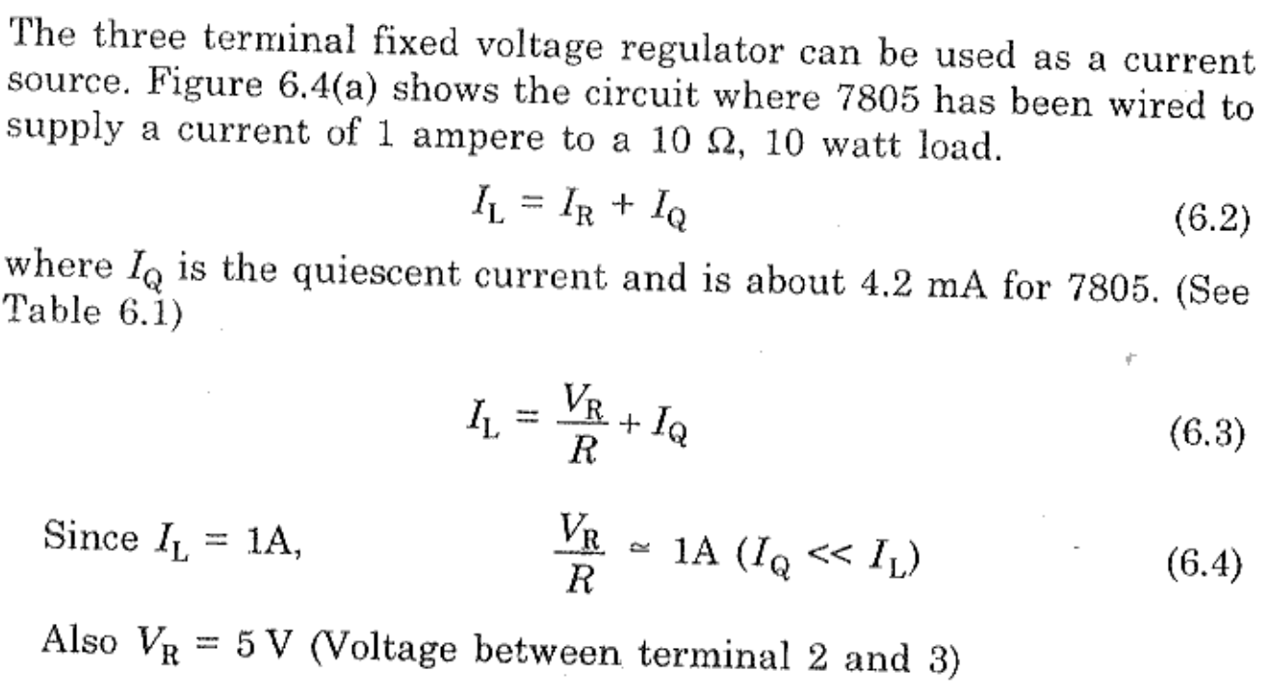
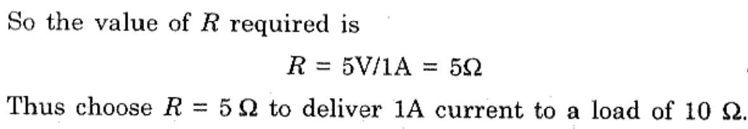
Voltage Regulators
7805 as Current Source

Slide 20
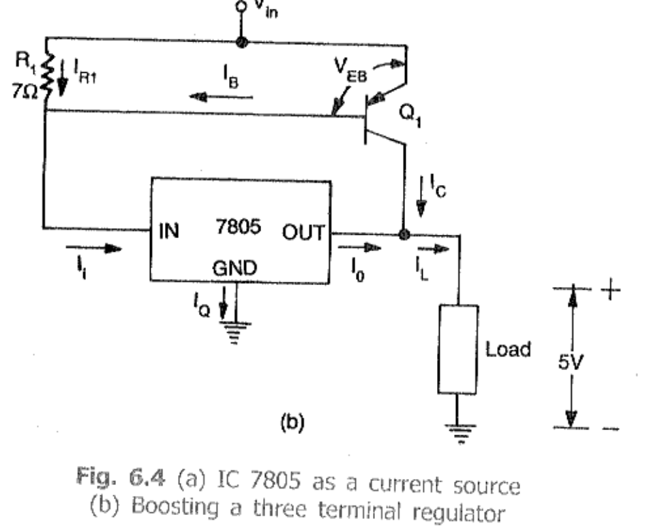
Voltage Regulators
7805 as Boosting IC Regulator Output Current

Slide 21
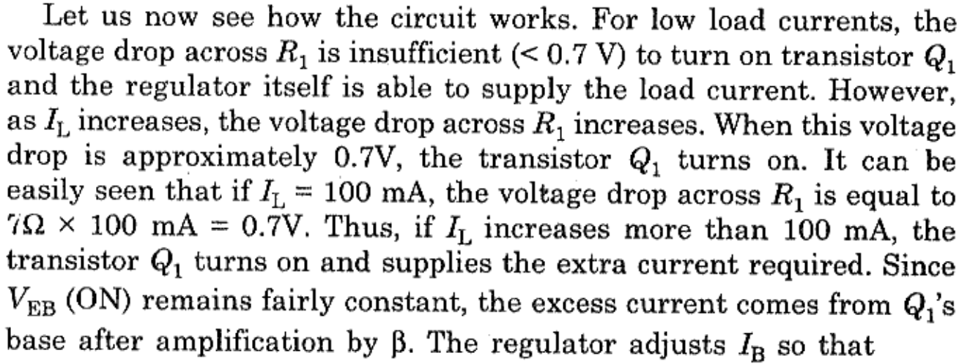
Voltage Regulators
7805 as Boosting IC Regulator Output Current

Slide 22
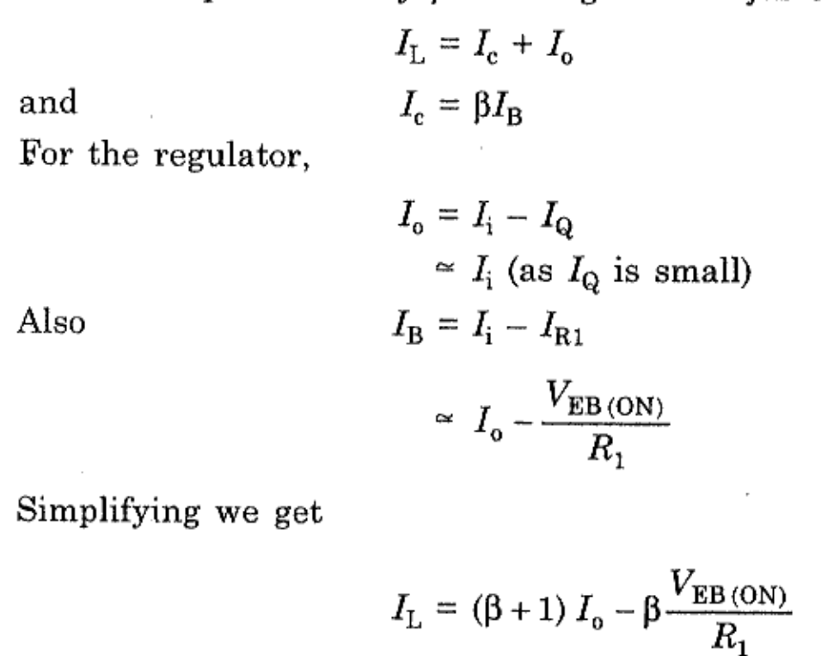
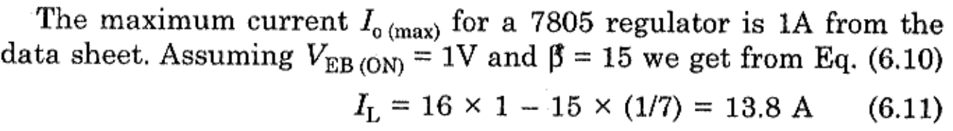
Voltage Regulators
7805 as Boosting IC Regulator Output Current

Slide 23
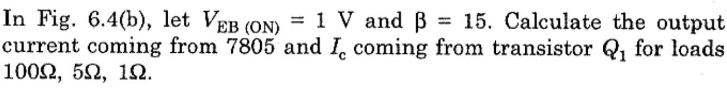
Voltage Regulators
7805 as Boosting IC Regulator Output Current

Slide 24
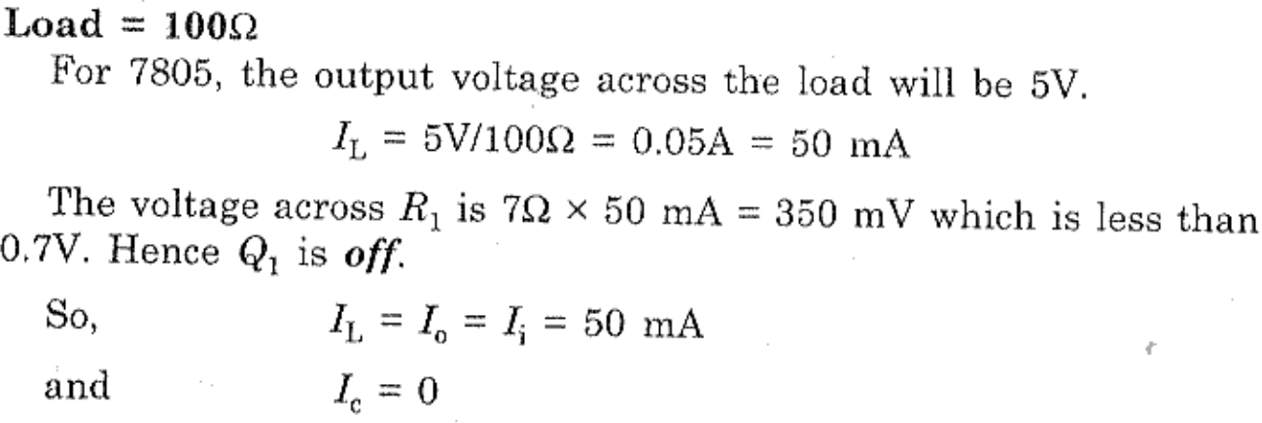
Voltage Regulators
7805 as Boosting IC Regulator Output Current

Slide 25
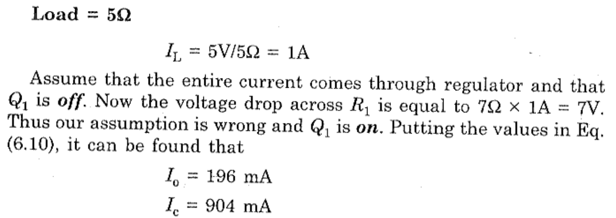
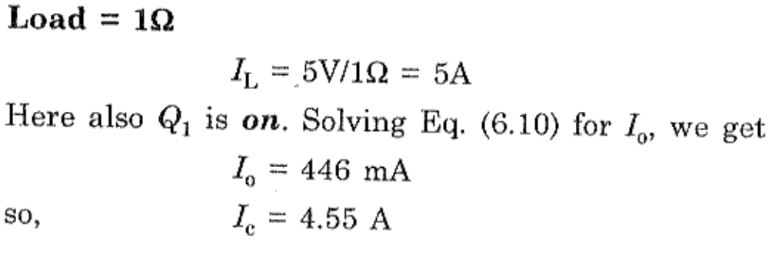
Voltage Regulators
7805 as Boosting IC Regulator Output Current

Slide 26
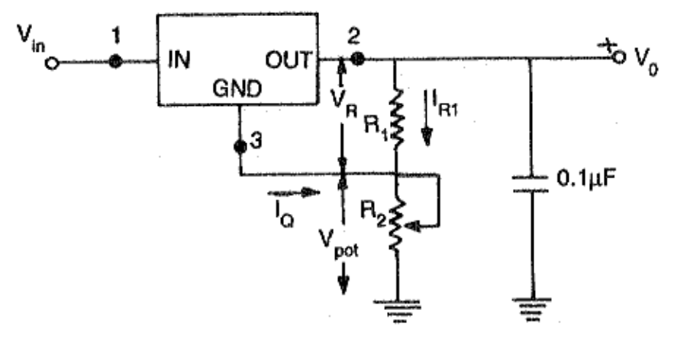
Voltage Regulators
7805 as Adjustable Voltage Regulator

Slide 27
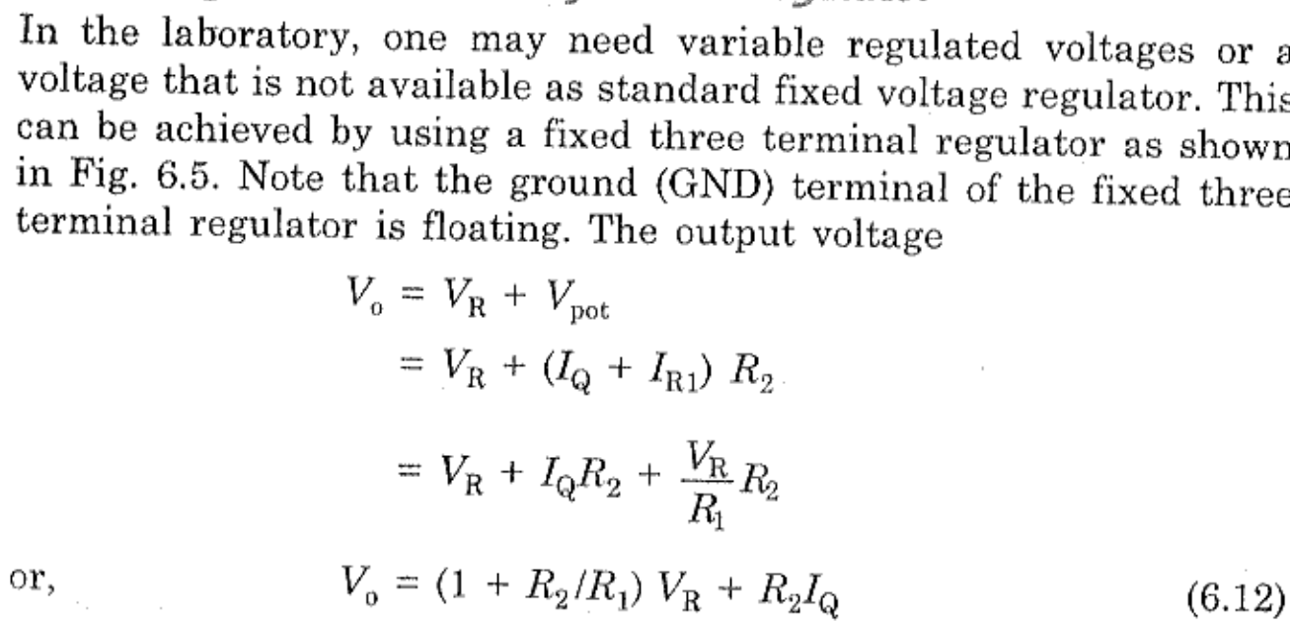
Voltage Regulators
7805 as Adjustable Voltage Regulator

Slide 28
Voltage Regulators
7805 as Adjustable Voltage Regulator

Slide 29
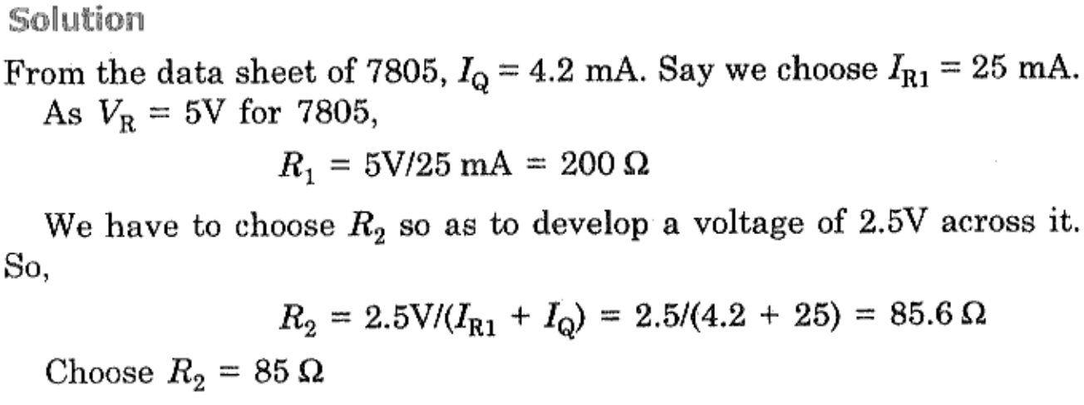
Voltage Regulators
7805 as Adjustable Voltage Regulator

Slide 30
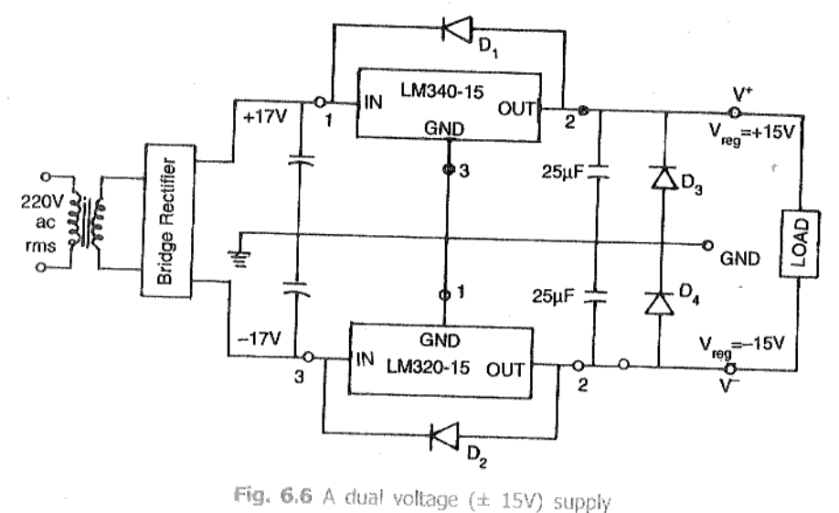
Voltage Regulators
7805 as Dual Voltage Supply
LM340 → +15V; LM320 → -15V.
D₁ and D₂ to protect regulator against Short Circuit
D₃ and D₄ to provide protection against turn on both the regulators at the same time.
During operation D₃ and D₄ are in reverse biased condition

Slide 31
Voltage Regulators
723 General Purpose Voltage Regulator
Disadvantages of fixed voltage regulator:
Do not have the shot circuit
Output voltage is not adjustable
These limitations can be overcomes in IC723.
Features of IC723:
Unregulated dc supply voltage at the input between 9.5V & 40V
Adjustable regulated output voltage between 2 to 3V.
Maximum load current of 150 mA (ILmax = 150mA).
With the additional transistor used, ILmax upto 10A is obtainable.
Positive or Negative supply operation
Internal Power dissipation of 800mW.
Built in short circuit protection.
Very low temperature drift.
High ripple rejection.

Slide 32
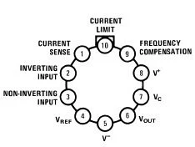
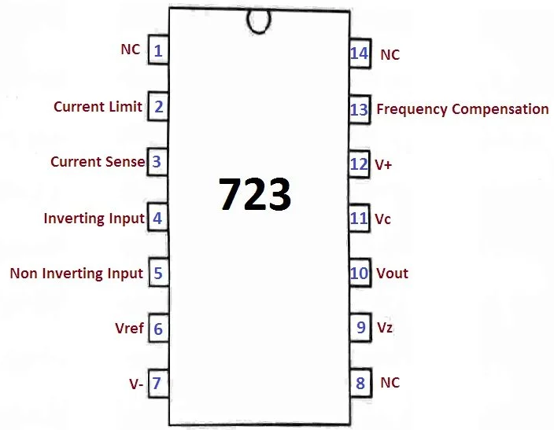
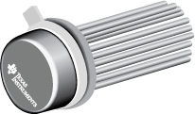
Voltage Regulators
723 General Purpose Voltage Regulator

Slide 33
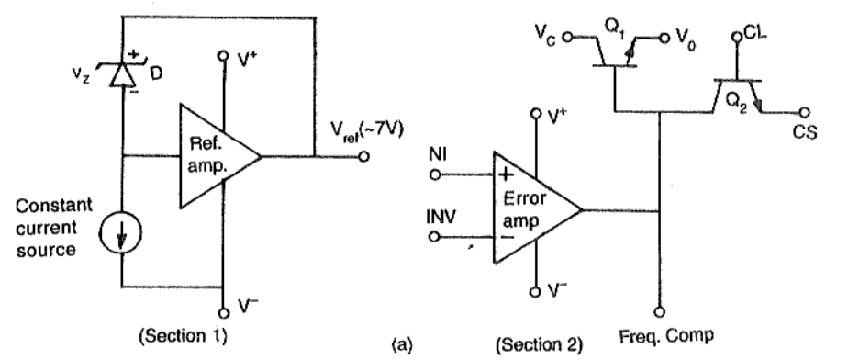
Voltage Regulators
723 General Purpose Voltage Regulator
The simplified functional block diagram can be divided in to 4 blocks.
Reference generating block
Error Amplifier
Series Pass transistor
Circuitry to limit the current

Slide 34
Voltage Regulators
723 General Purpose Voltage Regulator
1. Reference Generating block:
The temperature compensated Zener diode, constant current source & voltage reference amplifier together from the reference generating block. The Zener diode is used to generate a fixed reference voltage internally. Constant current source will make the Zener diode to operate at affixed point & it is applied to the Non – inverting terminal of error amplifier. The Unregulated input voltage ±Vcc is applied to the voltage reference amplifier as well as error amplifier.
2. Error Amplifier:
Error amplifier is a high gain differential amplifier with 2 input (inverting & Non-inverting). The Non-inverting terminal is connected to the internally generated reference voltage. The Inverting terminal is connected to the full regulated output voltage.

Slide 35
Voltage Regulators
723 General Purpose Voltage Regulator
3. Series Pass Transistor:
Q₁ is the internal series pass transistor which is driven by the error amplifier. This transistor actually acts as a variable resistor & regulates the output voltage. The collector of transistor Q₁ is connected to the Un-regulated power supply. The maximum collector voltage of Q₁ is limited to 36Volts. The maximum current which can be supplied by Q₁ is 150mA.
4. Circuitry to limit the current:
The internal transistor Q₂ is used for current sensing & limiting. Q₂ is normally OFF transistor. It turns ON when the IL exceeds a predetermined limit.

Slide 36
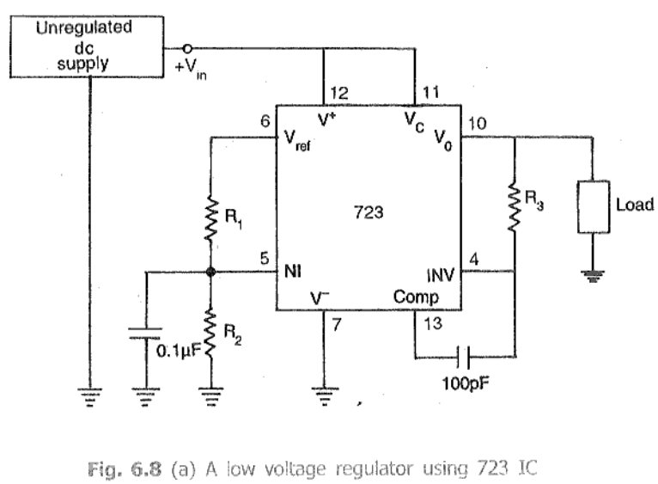
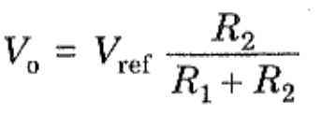
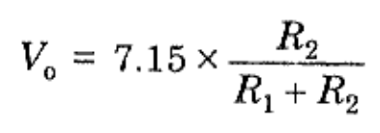
Voltage Regulators
723 General Purpose Voltage Regulator (LOW)

Slide 37
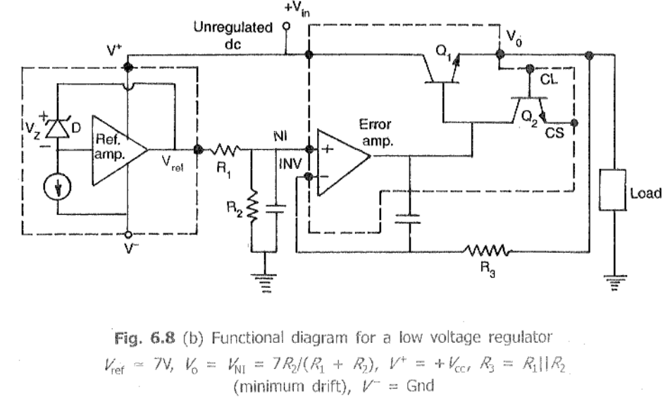
Voltage Regulators
723 General Purpose Voltage Regulator (LOW)

Slide 38
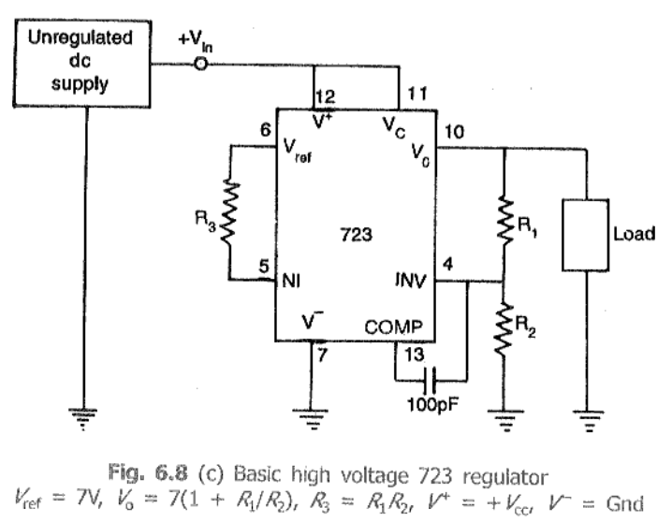
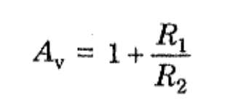
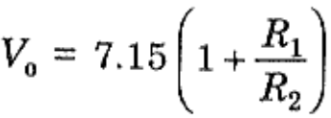
Voltage Regulators
723 General Purpose Voltage Regulator (HIGH)

Slide 39
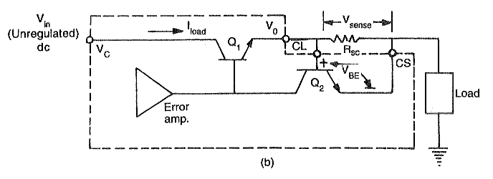
Voltage Regulators
723 General Purpose Voltage Regulator - with Current Limit Protection

Slide 40
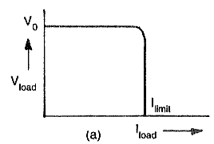

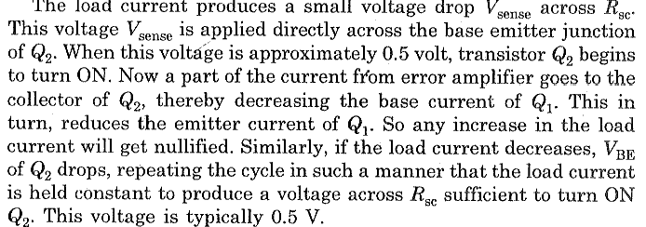
Voltage Regulators
723 General Purpose Voltage Regulator - with Current Limit Protection

Slide 41
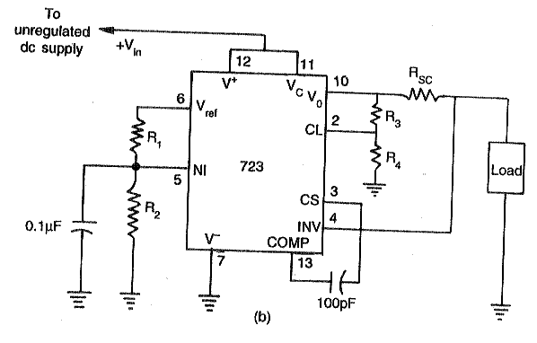
Voltage Regulators
723 General Purpose Voltage Regulator - with Current Foldback

Slide 42
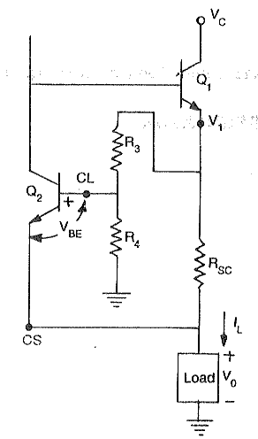
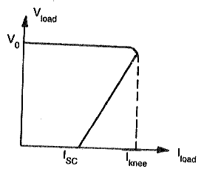
Voltage Regulators
723 General Purpose Voltage Regulator - with Current Foldback

Slide 43
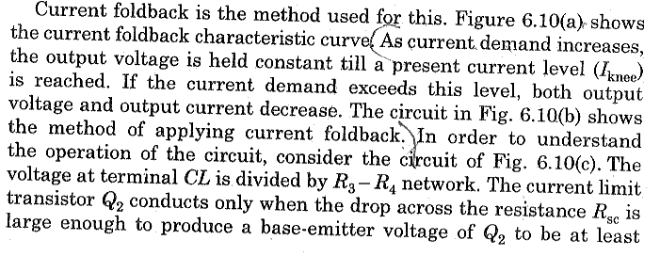
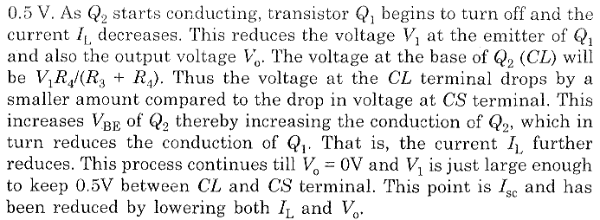
Voltage Regulators
723 General Purpose Voltage Regulator - with Current Foldback

Slide 44
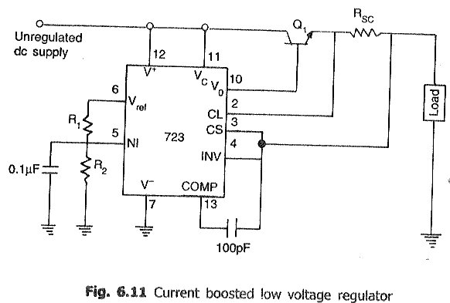
Voltage Regulators
723 General Purpose Voltage Regulator - with Current Boosting

Slide 45
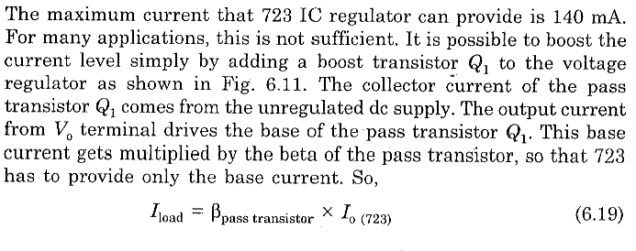
Voltage Regulators
723 General Purpose Voltage Regulator - with Current Boosting

Slide 46
https://www.circuitstoday.com/ic-voltage-regulators
https://learnabout-electronics.org/PSU/psu23.php

